Slide 1
MCE 412 - Autonomous Robotics
Probabilities and Bayes Review

Slide 2
Introduction
Probability finds application throughout many scientific fields, finds particular use in robotics in the modelling of uncertainty in terms of a vehicle’s pose, interpretating sensor data and mapping.
These slides review some of the fundamental aspects of probability and relates these aspects to problems in the mobile robotics domain.
Probability theory provides a general technique for describing the variations on system behaviours or observations.

Slide 3
Key Idea
Explicit representation of uncertainty (using the calculus of probability theory)
Perception = state estimation
Action = utility optimization

Slide 4

Axioms of Probability Theory
$0≤P\left(A\right)≤1$
$P\left(True\right)=1$, $P\left(False\right)=0$
$P\left(A∪B\right)=P\left(A\right)+P\left(B\right)−P(A∩B)$
$$P\left(A∪A^{′}\right)=P\left(A\right)+P\left(A^{′}\right)−P\left(A∩A^{′}\right)$$
$$P\left(True\right)=P\left(A\right)+P\left(A^{′}\right)−P\left(False\right)$$
$$1=P\left(A\right)+P\left(A^{′}\right)−0$$
$$P\left(A^{′}\right)=1−P\left(A\right)$$

Slide 5

Discrete Random Variables
X denotes a random variable
X can take on a countable number of values in $\{x_{1},x_{2},⋯,x_{n}\}$
$P\left(X=x_{i}\right)$ or $P\left(x_{i}\right)$ is the probability that the random variable X takes on value $x_{i}$
$P\left(.\right)$ is called the probability mass function
e.x. $P\left(Room\right)= 〈0.7, 0.2, 0.08, 0.02〉$

Slide 6

Continuous Random Variables
X takes on values in the continuum
p$\left(X=x\right)$ or p$\left(x\right)$ is a probability density function
$p\left(x∈\left[a,b\right]\right)= \int_{a}^{b}{p(x)dx}$

Slide 7

Probability Sums up to One
Discrete case Continuous case
$\sum_{x}{P\left(x\right)}=1$ $\int{p(x)dx}=1$

Slide 8
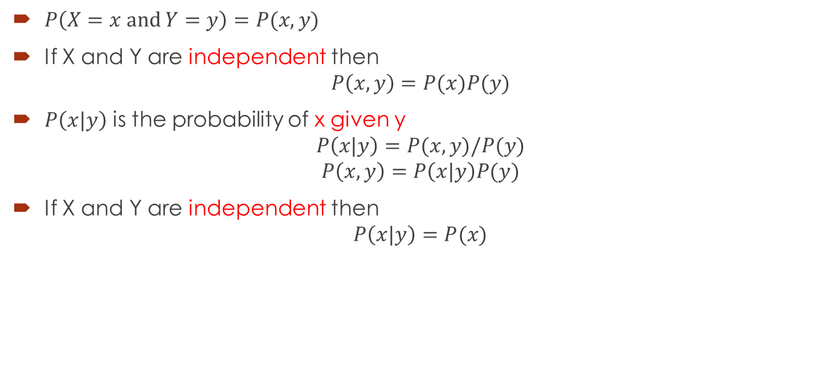
Joint and Conditional Probability
$P\left(X=x and Y=y\right)=P(x,y)$
If X and Y are independent then
$$P\left(x,y\right)=P(x)P(y)$$
$P\left(x|y\right)$ is the probability of x given y
$$P\left(x|y\right)=P(x,y)/P(y)$$
$$P\left(x,y\right)=P\left(x|y\right)P(y)$$
If X and Y are independent then
$$P\left(x|y\right)=P(x)$$

Slide 9

Law of Total Probability
Discrete case Continuous case
$P\left(x\right)=\sum_{y}{P\left(x|y\right)P(y)}$ $p\left(x\right)=\int{p(x|y)p(y)dy}$

Slide 10
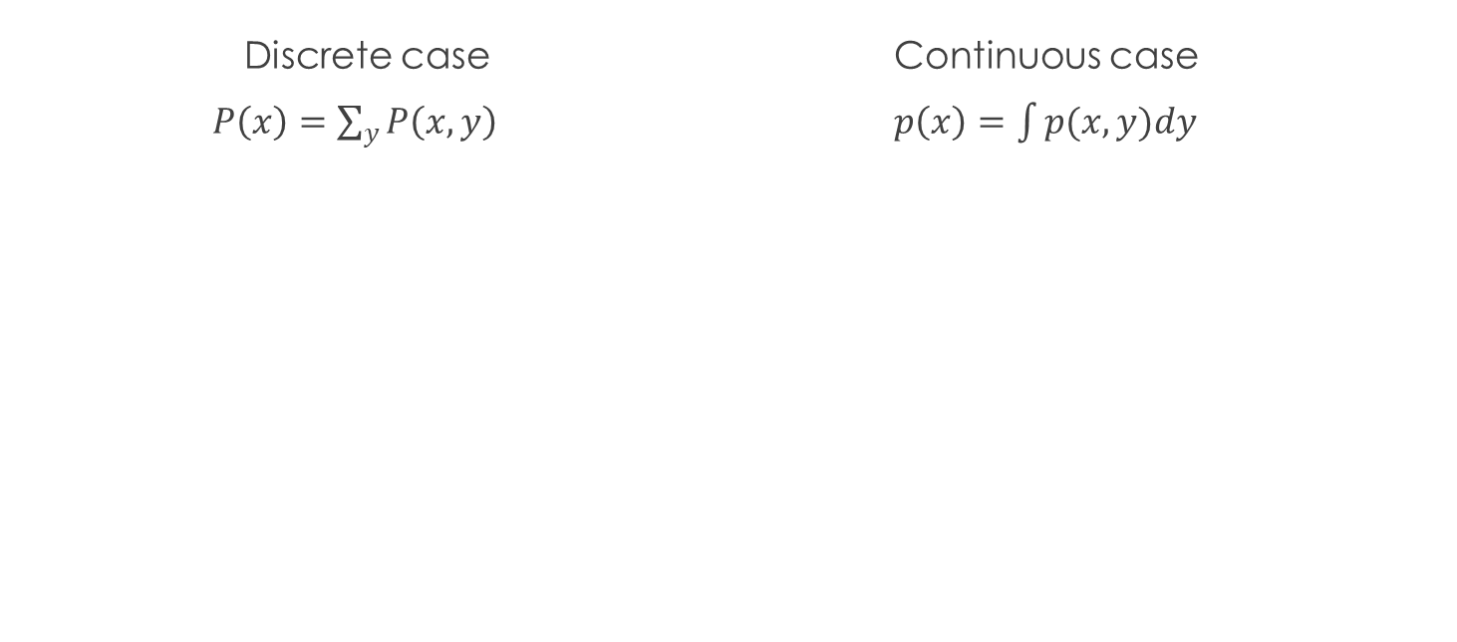
Marginalization
Discrete case Continuous case
$P\left(x\right)=\sum_{y}{P\left(x,y\right)} p\left(x\right)=\int{p(x,y)dy}$

Slide 11

Bayes Formula
$$P\left(x,y\right)=P\left(x|y\right)P\left(y\right)=P\left(y|x\right)P\left(x\right)$$
$$P\left(x|y\right)=\frac{P\left(y|x\right)P(x)}{P\left(y\right)}=\frac{likelihood.prior}{evidence}$$

Slide 12


Normalization
$$P\left(x|y\right)=\frac{P\left(y|x\right)P(x)}{P\left(y\right)}=ηP\left(y|x\right)P(x)$$
$$η={P(y)}^{−1}=\frac{1}{\sum_{x}{P\left(y|x\right)P(x)}}$$
Algorithm:
$$∀x:{aux}_{x|y}=P(y|x)P(x)$$
$$η=\frac{1}{\sum_{x}{{aux}_{x|y}}}$$
$$∀x:P\left(x | y\right)=η{aux}_{x|y}$$

Slide 13

Bayes Rule with Background Knowledge
$$P\left(x | y,z\right)= \frac{P(y|x,z)P(x|z)}{P(y|z)}$$

Slide 14
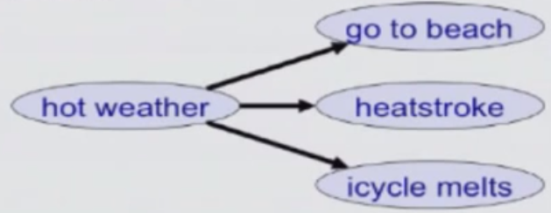

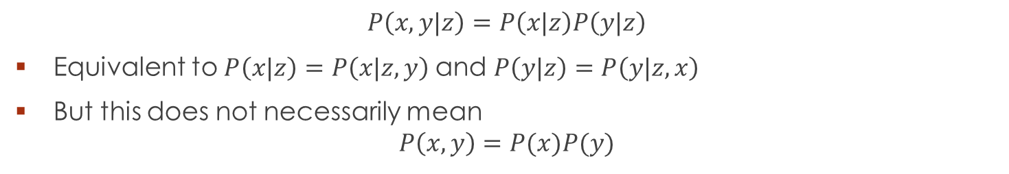

Conditional Independence
$$P\left(x,y|z\right)=P\left(x|z\right)P\left(y|z\right)$$
Equivalent to $P\left(x|z\right)=P\left(x|z,y\right)$and $P\left(y|z\right)=P\left(y|z,x\right)$
But this does not necessarily mean
$$P\left(x,y\right)=P(x)P(y)$$
Example:
Probabilities of going to the beach and getting a heat stroke are not independent:
Might be independent if we know the wheather is hot
Hot weather ‘explains’ all the dependence betwen beach and heatstroke
$$P\left(B,S\right)>P\left(B\right)P(S)$$
$$P\left(B,S|H\right)>P\left(B|H\right)P(S|H)$$

Slide 15
Simple Example of State Estimation
Suppose robot obtains a measurement z
What is p(open|z)?

Slide 16

Causal vs. Diagnostic Reasoning
P(open|z) is diagnostic
P(z|open) is causal
In some situations, causal knowledge is easier to obtain. Bayes rule allows us to use causal knowledge.
$$p\left(open | z\right)=\frac{p\left(z | open\right)p(open)}{p(z)}$$

Slide 17

Example
$P\left(z|open\right)=0.6$ $P\left(z|open′\right)=0.3$
$P\left(open\right)=P\left(open^{′}\right)=0.5$
$P\left(open|z\right)=\frac{P(z|open)P(open)}{P\left(z | open\right)P\left(open\right)+P(z|open′)P(open′)}$
$P\left(open|z\right)=\frac{0.6∗0.5}{0.6∗0.5+0.3∗0.5}=0.67$
z raises the probability that the door is open

Slide 18

Combining Evidence
Suppose our robot obtains another observations $z_{2}$
How can we integrate this new information?
More generally, how can we estimate $P\left(x | z_{1}, ⋯{,z}_{n}\right)$?

Slide 19

Recursive Bayesian Updating
$P\left(x | z_{1}, ⋯{,z}_{n}\right)= \frac{P(z_{n}|x,z_{1}, ⋯{,z}_{n−1})P(x|z_{1}, ⋯{,z}_{n−1})}{P(z_{n}|z_{1}, ⋯{,z}_{n−1})}$
Markov assumption:
$z_{n}$ is independent of $z_{1}, ⋯{,z}_{n−1}$ if we know x
$P\left(x | z_{1}, ⋯{,z}_{n}\right)= \frac{P(z_{n}|x)P(x|z_{1}, ⋯{,z}_{n−1})}{P(z_{n}|z_{1}, ⋯{,z}_{n−1})}$
$$P\left(x | z_{1}, ⋯{,z}_{n}\right)=η P(z_{n}|x)P(x|z_{1}, ⋯{,z}_{n−1})$$
$$P\left(x | z_{1}, ⋯{,z}_{n}\right)=η_{1,⋯,n} [ \prod_{i=1,⋯n}{P\left(z_{i} | x\right)}]P(x)$$

Slide 20

Example: Second Measurement
$P(z_{2}|open)=0.25$ $P\left(z_{2}|open′\right)=0.3$
$P\left(open|z_{1}\right)=2/3$
$P\left(open|z_{2},z_{1}\right)=\frac{P(z_{2}|open)P(open|z_{1})}{P\left(z_{2} | open\right)P\left(open|z_{1}\right)+P(z_{2}|open′)P(open^{′}|z_{1})}$
$P\left(open|z\right)=\frac{\frac{1}{4}∗\frac{2}{3}}{\frac{1}{4}∗\frac{2}{3}+\frac{3}{10}∗\frac{1}{3}}=0.625$
$z_{2}$ lowers the probability that the door is open

Slide 21
Typical Actions
The robot turns its wheels to move
The robot uses its manipulator to grasp an object
Plants grow over time
Actions are never carried out with absolute certainty
In contrast to measurements, actions generally increase the uncertainty

Slide 22

Modeling Actions
To incorporate the outcome of an action u into the current ‘belief’, we use the conditional pdf
$$P\left(x | u,x′\right)$$
This term specifies the pdf that executing u changes the state from x’ to x.

Slide 23
Example: Closing the door

Slide 24
State Transitions

Slide 25
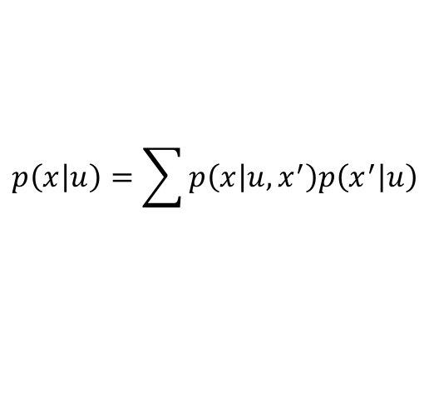
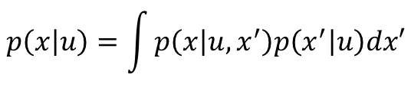
Integrating the Outcome of Actions
Continuous case:
Discrete case:
We will make an independence assumption to get rid of the u in the second factor in the sum.
$$p\left(x | u\right)=\int{p\left(x | u,x^{′}\right)p\left(x^{′} | u\right)dx′}$$
$$p\left(x | u\right)=\sum{p\left(x | u,x^{′}\right)p\left(x^{′} | u\right)}$$

Slide 26
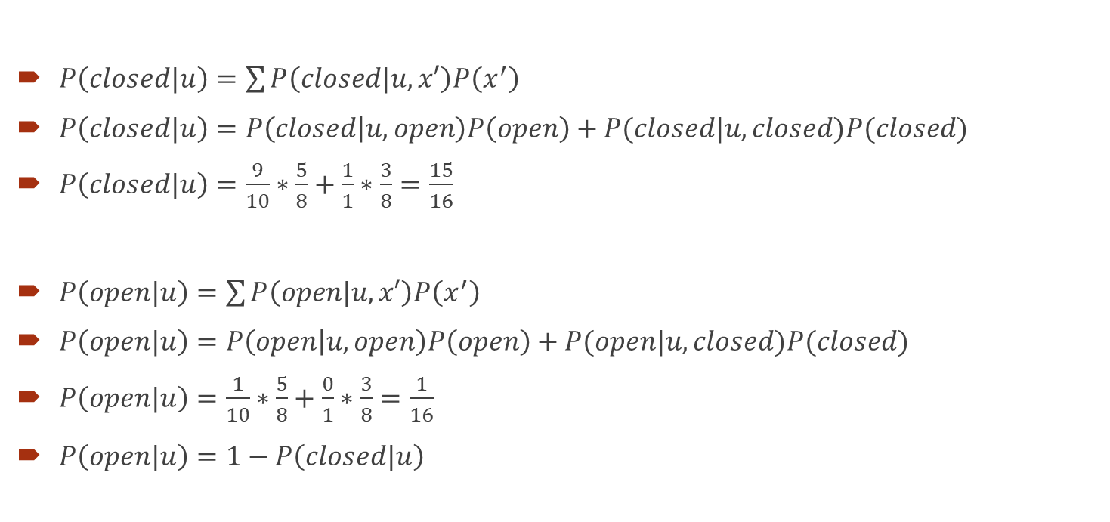
Example: The Resulting Belief
$P\left(closed|u\right)=\sum{P\left(closed|u,x′\right)P\left(x^{′}\right)}$
$P\left(closed|u\right)=P\left(closed | u,open\right)P\left(open\right)+P(closed|u,closed)P(closed)$
$P\left(closed|u\right)=\frac{9}{10}∗\frac{5}{8}+\frac{1}{1}∗\frac{3}{8}=\frac{15}{16}$
$P\left(open|u\right)=\sum{P\left(open|u,x′\right)P\left(x^{′}\right)}$
$P\left(open|u\right)=P\left(open | u,open\right)P\left(open\right)+P(open|u,closed)P(closed)$
$P\left(open|u\right)=\frac{1}{10}∗\frac{5}{8}+\frac{0}{1}∗\frac{3}{8}=\frac{1}{16}$
$P\left(open|u\right)=1−P\left(closed|u\right)$

Slide 27

Bayes Filters: Framework
Given:
Stream of observations z and action data u:
$$d_{t}=\{u_{1},z_{1},⋯,u_{t},z_{t}\}$$
Sensor model $P\left(z|x\right)$
Action model $P\left(x|u,x′\right)$
Prior probability of the system state $P\left(x\right)$
Wanted:
Estimate of the state X of a dynamical system
The posterior of the state is also called Belief:
$$Bel(x_{t})=P(x_{t}|u_{1},z_{1},⋯,u_{t},z_{t})$$

Slide 28

Markov Assumption
Underlying Assumptions
Static World
Independent noise
Perfect model, no approximation errors
$$p\left(z_{t} | x_{0:t},z_{1:t−1},u_{1:t}\right)=p(z_{t}|x_{t})$$
$$p\left(x_{t} | x_{1:t−1},z_{1:t−1},u_{1:t}\right)=p(x_{t}|x_{t−1},u_{t})$$

Slide 29
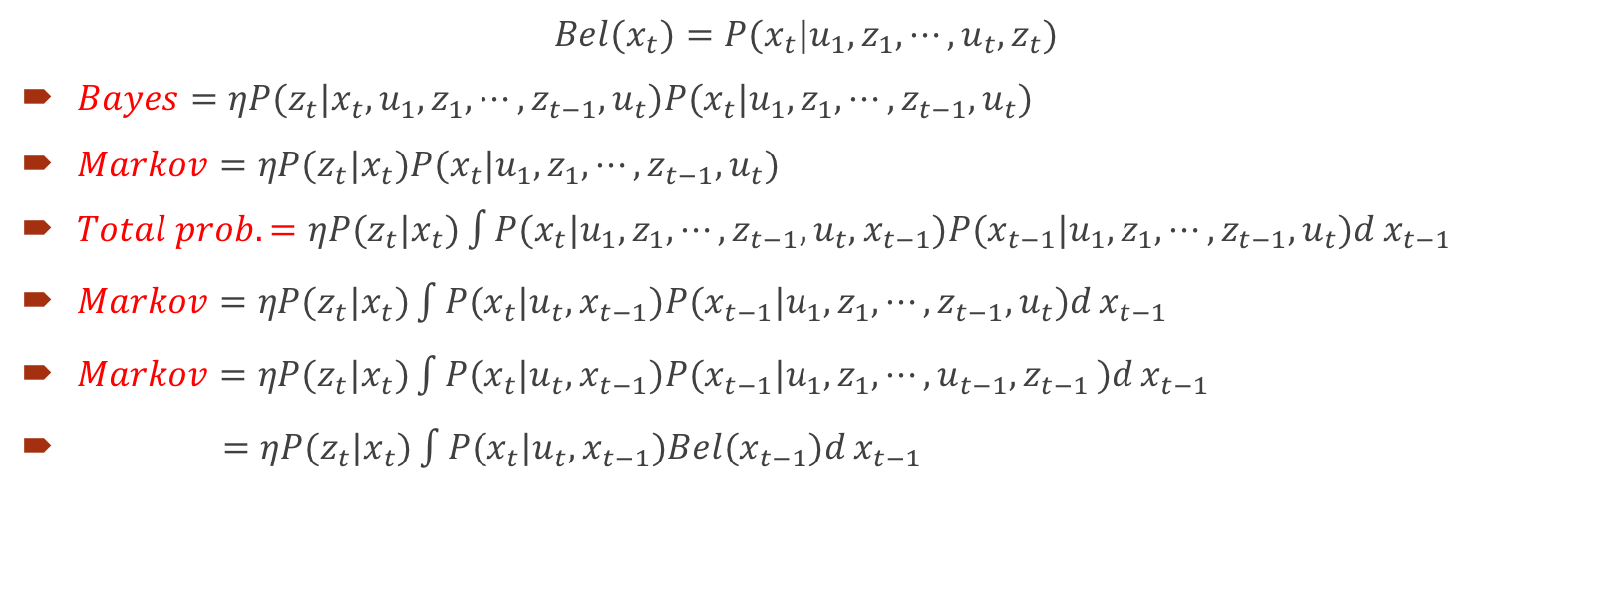
Bayes Filters
$$Bel(x_{t})=P(x_{t}|u_{1},z_{1},⋯,u_{t},z_{t})$$
$Bayes=ηP(z_{t}|x_{t},u_{1},z_{1},⋯,z_{t−1},u_{t})P(x_{t}|u_{1},z_{1},⋯,z_{t−1},u_{t})$
$Markov=ηP(z_{t}|x_{t})P(x_{t}|u_{1},z_{1},⋯,z_{t−1},u_{t})$
$Total prob.=ηP(z_{t}|x_{t})\int{P(x_{t}|u_{1},z_{1},⋯,{z_{t−1},u}_{t},x_{t−1})P(x_{t−1}|u_{1},z_{1},⋯,z_{t−1},u_{t})d}x_{t−1}$
$Markov=ηP(z_{t}|x_{t})\int{P(x_{t}|u_{t},x_{t−1})P(x_{t−1}|u_{1},z_{1},⋯,z_{t−1},u_{t})d}x_{t−1}$
$Markov=ηP(z_{t}|x_{t})\int{P(x_{t}|u_{t},x_{t−1})P(x_{t−1}|u_{1},z_{1},⋯,u_{t−1}{,z}_{t−1})d}x_{t−1}$
$=ηP(z_{t}|x_{t})\int{P(x_{t}|u_{t},x_{t−1})Bel(x_{t−1})d}x_{t−1}$

Slide 30
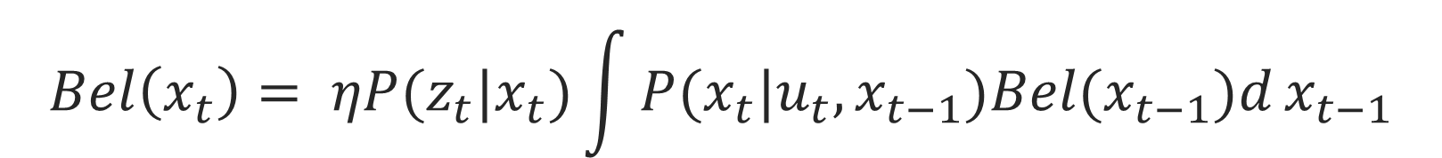
$$Bel\left(x_{t}\right)= ηP(z_{t}|x_{t})\int{P(x_{t}|u_{t},x_{t−1})Bel(x_{t−1})d}x_{t−1}$$
Sensor model
Action model
Prior belief (prediction)
Kalman Filters
Particle Filters

Slide 31
Probabilistic Localization

Slide 32
Probabilistic Localization

Slide 33
Summary
Bayes rule allow us to compute probabilities that are hard to assess otherwise
Under the Markov assumption, recursive Bayesian updating can be used to efficiently combine evidence
Bayes filters are a probabilistic tool for estimating the state of dynamic systems.

Slide 34
References
Probabilistic Robotics, Sebastian Thrun, Wolfram Burgard and Dieter Fox, Chapter 1 and 2

